Slide 1
Digital Literacy
Abdul Wahab Aslam (02-131222-132)
Muhammad Buland Bakht (02-131222-128)
Abdullah (02-131222-099)

Slide 2


What is digital literacy?
Digital literacy refers to the ability to use digital technologies effectively and responsibly to access, evaluate, create, and communicate information. It encompasses a range of skills, knowledge, and attitudes required to navigate the digital world and participate in the digital age. Digital literacy is a multifaceted concept that encompasses a wide range of skills and knowledge necessary to thrive in the digital age. It empowers individuals to use technology effectively, critically evaluate digital information.

Slide 3

Why does Digital literacy Matter?
Digital literacy is increasingly important in today’s digital world, as it enables individuals to participate fully in society and the economy. It can also help to bridge the digital divide, which refers to the gap between those who have access to digital technologies and those who do not.
Digital literacy encompasses a vast collection of skills that help users utilize digital tools to the fullest through finding, creating, sharing, and evaluating information. But also create a unique experience for all users.
Digital literacy is crucial as technology increasingly permeates all aspects of our lives, from education and employment to communication and social interaction.

Slide 4
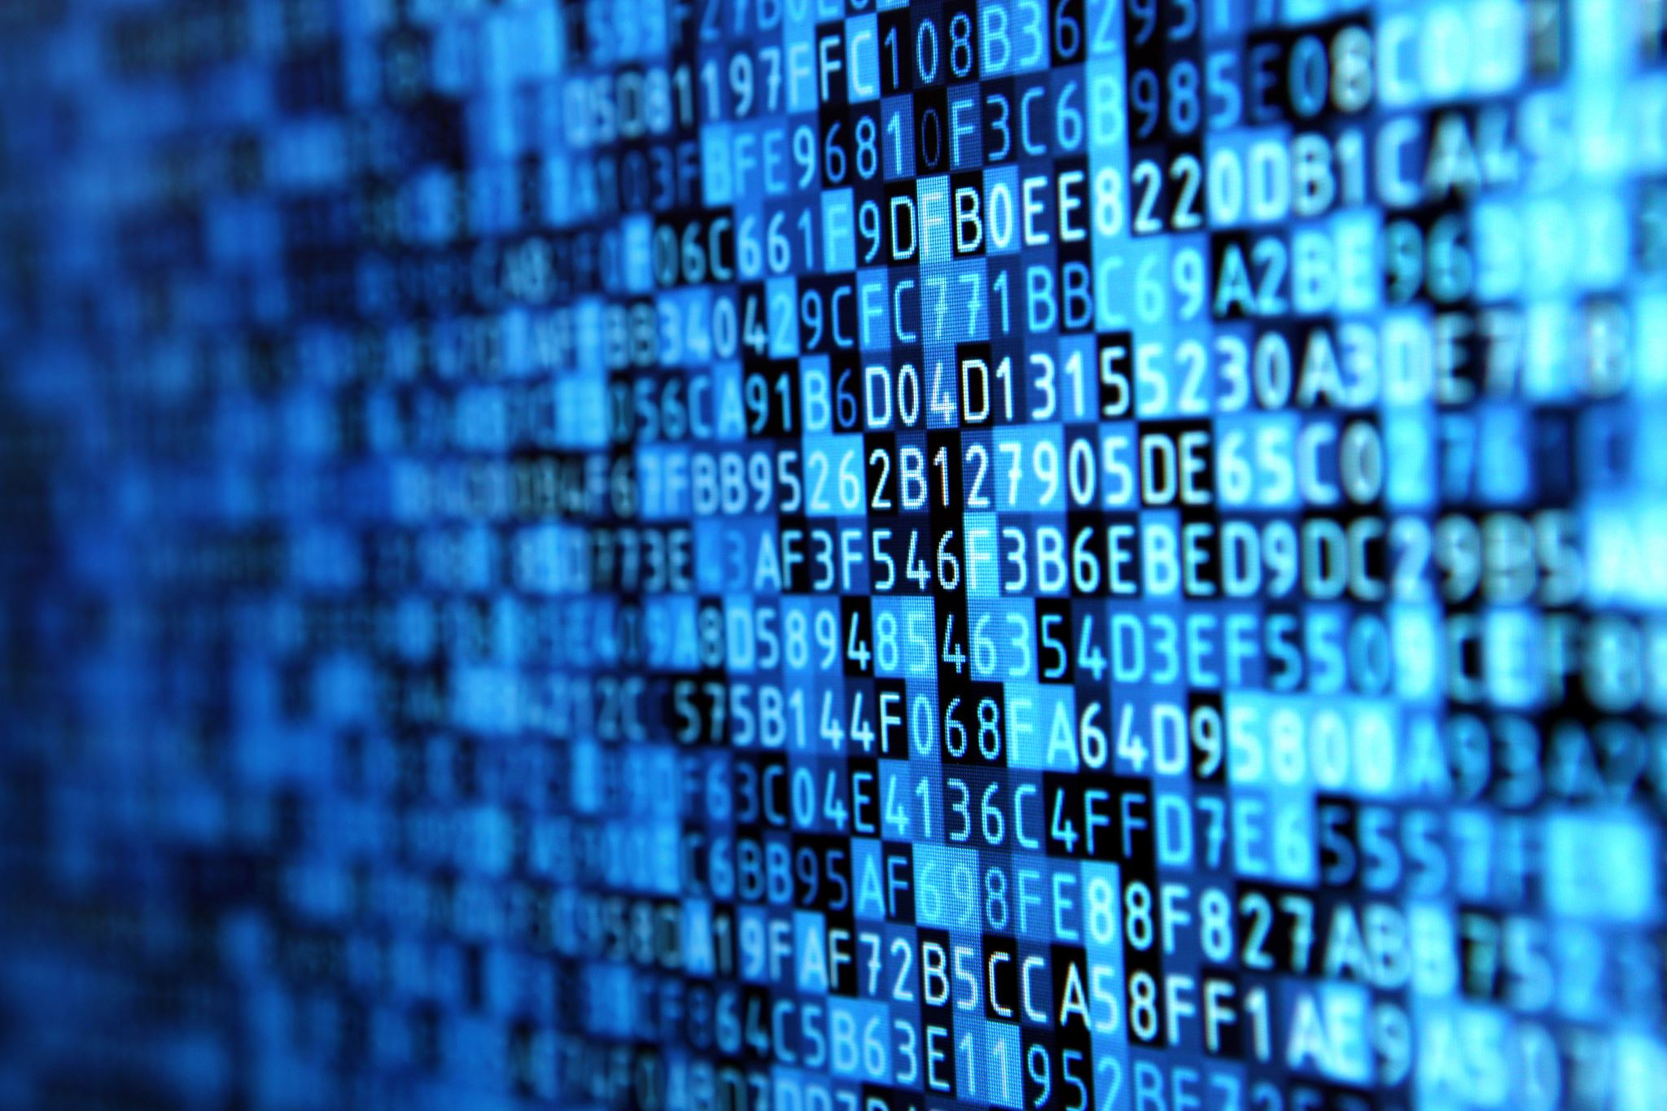
Key components of digital literacy
Digital literacy comprises several important components that enable individuals to navigate the digital landscape with confidence. These components are:
Digital Citizenship
Information Literacy.
Privacy & Security.

Slide 5

Digital citizenship
Digital literacy encompasses responsible and ethical behavior in the digital world. It involves understanding the rights and responsibilities of digital citizens, respecting others' digital rights, practicing online etiquette, and engaging in positive online communities. Digital citizenship also includes awareness of cyberbullying, online harassment, and appropriate behavior in online social interactions.

Slide 6

Information Literacy
Digital literacy requires the ability to locate, evaluate, and use information effectively from digital sources. It involves critical thinking skills to assess the accuracy, reliability, and relevance of online information. Information literacy also includes understanding concepts like plagiarism, copyright, and intellectual property rights.

Slide 7
Privacy & security
Digital literacy involves knowledge of how to protect personal information, maintain privacy, and stay safe online. This includes understanding concepts like strong passwords, secure browsing practices, avoiding phishing scams, and protecting against malware and viruses. Digital literacy also covers understanding the implications of sharing personal information online and the importance of privacy settings.

Slide 8
6C’s of Digital Literacy
Character
Critical thinking
Communication
Collaboration
Creativity
Citizenship

Slide 9

Case study
In late 2019, Ireland’s first National Digital Experience Survey (INDEX) was conducted. The survey identified that 38% of students had opportunities to review and update their digital skills (National Forum, 2020, p. 63). What about the other 62%? Could the library’s workshops provide a way for students to improve their digital skills?

Slide 10

Conclusion
Digital Literacy is about more than just using computers. To become digitally literate, it’s important to develop a range of skills. We need to be able to use technology to search for and create content, solve problems, and innovate. We need to be able to connect and communicate effectively online, learn, collaborate with peers, and discover and share new information. While doing all of this, we need to be able to recognize risk, stay safe online, protect their physical and emotional wellbeing, and practice positive online behaviors.

Slide 11
References
https://www.cambridge.org/elt/blog/2022/04/07/understanding-developing-digital-literacy/
https://www.westernsydney.edu.au/studysmart/home/study_skills_guides/digital_literacy/what_is_digital_literacy
https://potomac.edu/what-is-digital-literacy/
https://thedigitalfury.com/what-is-digital-literacy/

Slide 12
Thank You

